Slide 1
Hotel Management System
Group 6

Slide 2
Aim
There are lot of complicated things to handle when managing a hotel
Room reservation
Facility management
Income and expenditure management
Staff handling
Handling data about employees and guests
Manually handling above facts are difficult.
So an automated system can be implemented to handle above facts automatically.

Slide 3
Outcomes
Easy to
maintain database
Use GUI
More accurate in calculations

Slide 4
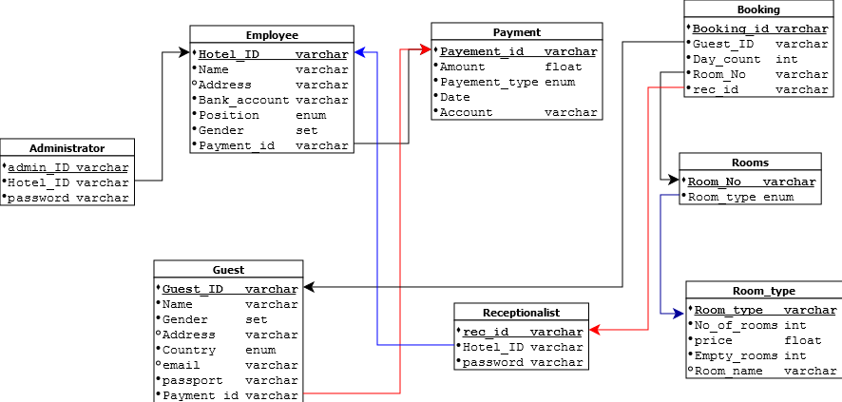
Relational Schema

Slide 5
Time line
 | week 1 | week 2 | week 3 | week 4 | week 5 | week 6 | week 7 | week 8 | week 9
Problem analysis
Designing ER diagram
Data modelling and mapping
Logical and physical designing of database
Implementation

